Slide 1
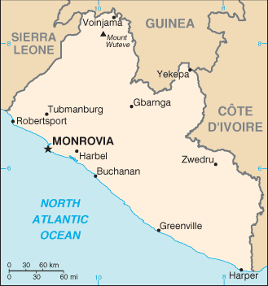

Liberia Media Analysis
By Nathan Danielsen

Slide 2
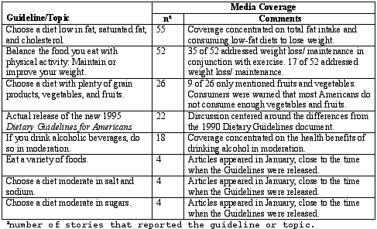
Problem
How do we assess the impact and measure the effectiveness of USG government funded media capacity building projects?
Current Solutions are:
Labor intensive (manual scoring)
Expensive (staff and training time)
Small samples ( < 500 )
Scored content is hard to access
Subjective
Not real time

Slide 3

A Better Way?
Automating Data Collection (content scraping)
Modeling Media Coverage As a Baseline Assessment
Reproducibility (Raw data is saved for further analysis)
Reusable tools/ code
More objective?

Slide 4
Research Questions
Do local media outlets in Liberia adequately provide media coverage of the entire country?
What are the predictors of media coverage in Liberia?
Test Case
How did local media outlets in Liberia cover events before, during and after the Ebola crisis?
Was media coverage representative of the geographical scope and extent of the Ebola outbreak?

Slide 5
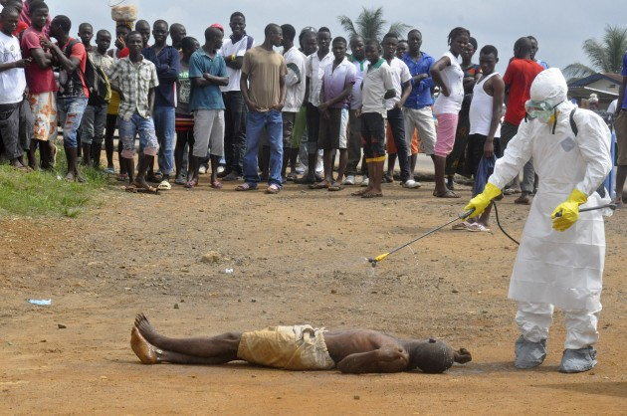
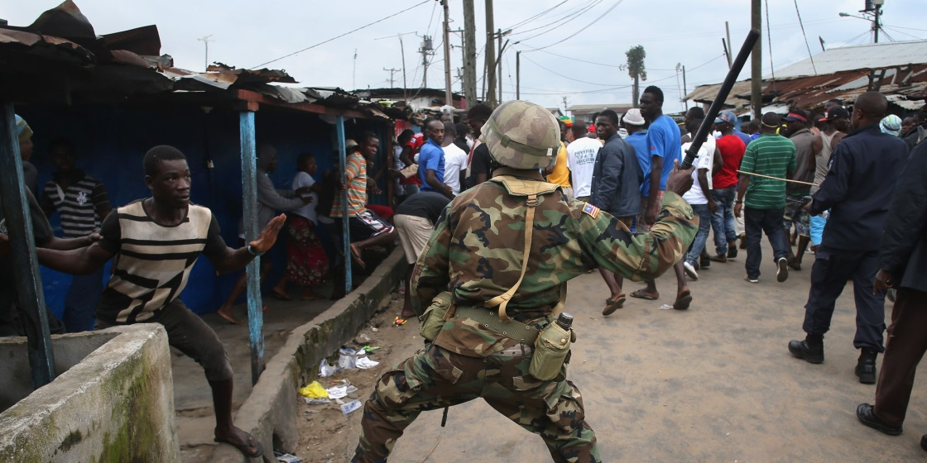
Famous Images from the Ebola Outbreak

Slide 6
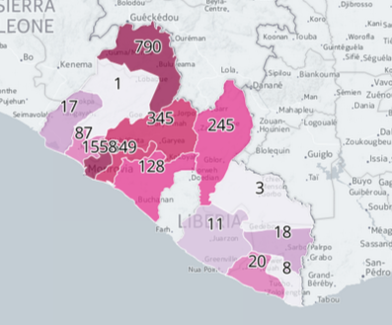
Hypothesis
I hypothesize that timely and accurate media coverage of significant events in Liberia is determined by population density, availability (and functionality) of telecommunications infrastructure, levels of literacy, and ethnic and linguistic divisions.
Source: http://ebolainliberia.org/

Slide 7
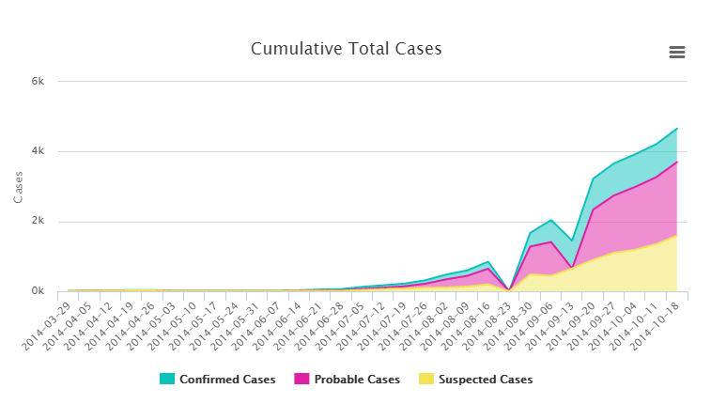
Visualization (Not Mine)
Source: http://ebolainliberia.org/

Slide 8
Data Collection Plan
Scrape all the online media content “stories” from 9 local media outlets.
Demographic and Health Survey Data
Accurate and representative data on population, health, HIV, and nutrition
Fairly Tidy
Ebola Time Series by Region Data from HDX
Humanitarian Data Exchange (HDX)
Fairly Tidy

Slide 9
Media Content Tasks
Build Scraper (Nearly Done)
Data Extraction and Cleaning (Nearly Done)
Title
Post Date
Author
Story Lead (First ~4 sentences)
Entire Story
Feature Extraction (Partially done)
Named Entity Recognition (Names, Locations, Organizations, etc)
Story Category
Keywords
Sentiment
LDA

Slide 10
Modeling Plan
Time Series of Media Coverage (# stories per day, week, month covering a region, story category etc.)
Determine predictors of Media Coverage with DHS data using logistical regression and clustering
Model sentiment by publication and author for regions and/ or story category.

Slide 11
Modeling Test Cases
As the Ebola outbreak starts, does news coverage follow casualty counts?
Is there a correlation?
Since the Ebola outbreak has receded, has media coverage returned to the pre-outbreak model?

Slide 12

Project Status
Web Scraper Issues
Collection Rules:
False Positives (Redirects from a page that does not exist to the homepage. No 404 error and scaper collects it)
Media Content Feature Extraction
Extraction Rules:
Need to customize scraper to each media outlet
Modeling
Haven’t started yet.

